Slide 1
Logistics: Project
Project presentation (next week in lectures)
Everyone is expected to attend both lectures
10 minutes for presentation + 1~2 minutes for QA and transition
Dec 6 | Ming Gao, Boyan Tian, Jiayi Zhang
 | Ruowen Xu, Yucen Zhong
 | Jiajun Sun, Xianchun Zeng, Miao Qin
 | David Sarpong, Alex Wollam
 | Cenhao Li, Ruiwei Xiao, Yang Yi
 | Aayush Dhakal, Subash Khanal
Dec 8 | Tejas Mattur, Run Zhang, Jacob Dodd
 | Yiding Tao, Xiangyu Chen
 | Danielle Beaulieu, Kaushik Dutta
 | Qihang Huang, Zheng Wang, Zhuomin Li
 | Daisy Wang, Xinyi Ye

Slide 2
Logistics: Project
Project report
Due: Dec 9 (no late submissions)
Up to 6 pages (plus unlimited number of pages for only references/citations)
No strict format requirements
You are encouraged to use standard templates, such as AAAI format or NeurIPS format
For research projects
Your report should be structured in a way similar to the research papers we have read throughout the semester. (e.g., include introduction, related work, research problem or formulation, your proposed approach, results, conclusions).
For literature surveys
Do not summarize papers one by one. Find a theme, categorize papers, and put them in context.
Example: Making Better Use of the Crowd: How Crowdsourcing Can Advance Machine Learning Research. Vaughan. JMLR 2018.

Slide 3
Assignment 4
Due this Friday
Check your late-day usages if you plan to use them
Check the list of talks on Piazza
Report requirement
At least two pages (in a reasonable format)
Should contain at least
Summary
Your thoughts (in a critical manner)
Connection to this course and future work

Slide 4
Reminder on The Grades (Copied from Lecture 1)
Condition on you complete all other requirements satisfactorily, your final grades are determined by your final project
A+: Your project is close to be published in top venues
A: I’m happy to use your project as model projects in the future
A-: Overall good but might be better (in reports/presentation/approaches/…)
B+ or lower: There are more significant flaws in the project (e.g., not well-motivated problems, major issues in result interpretation/explanation, etc)
Your final grades will be decreased from the above for missing reviews / homework issues / non-participation using the grading break-up in the syllabus
Follow the standard mapping (>93%: A, 90-93%: A-, … )

Slide 5
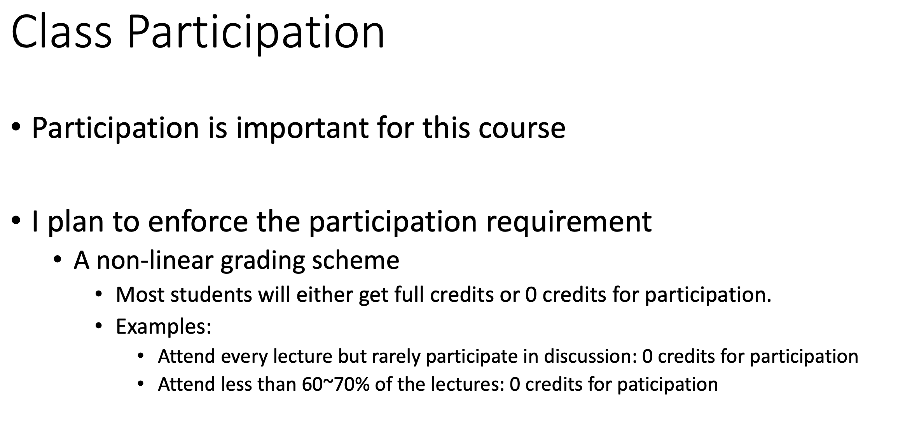
Reminder on The Grades (Copied from Lecture 1)

Slide 6
Peer Review
Please submit the peer review by 6pm

Slide 7
Lecture 22 AI-Assisted Decision Making
Instructor: Chien-Ju (CJ) Ho

Slide 8
Interactions between Human and AI
How AI learns from humans
Label aggregation
Incentive design
Biased input
How AI impacts humans
Fairness
Transparency / Explainability
Strategic manipulation
ML/AI
Human

Slide 9
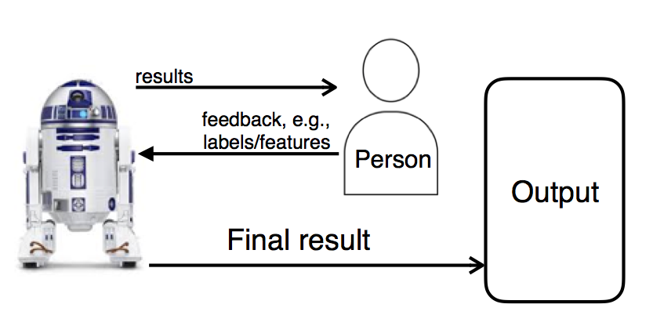
Human-in-the-Loop Machine Learning
Modeling human behavior
Aggregating noisy information contributed by humans
Designing incentives to encourage high-quality data
Addressing complex tasks through workflow or crowd collaborations
…

Slide 10
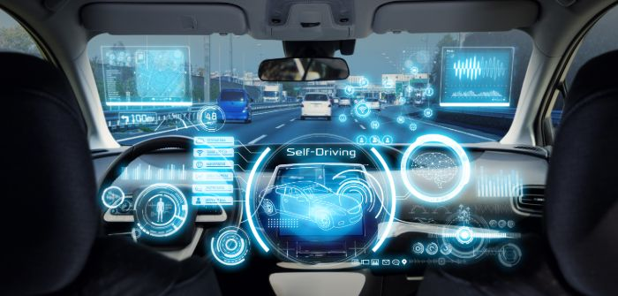
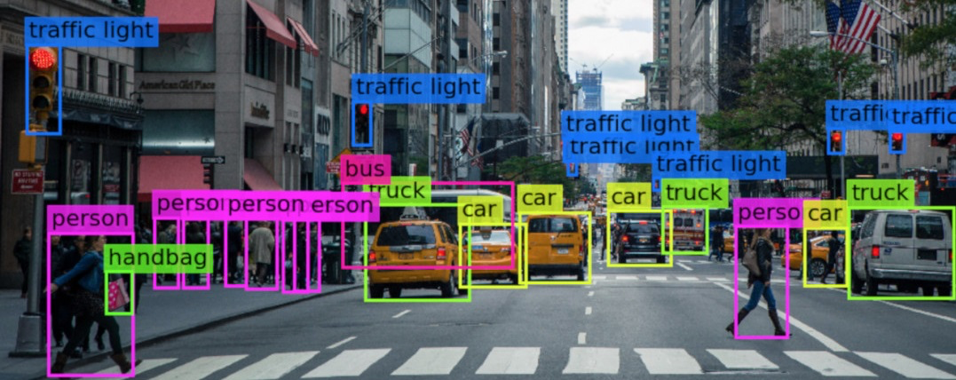
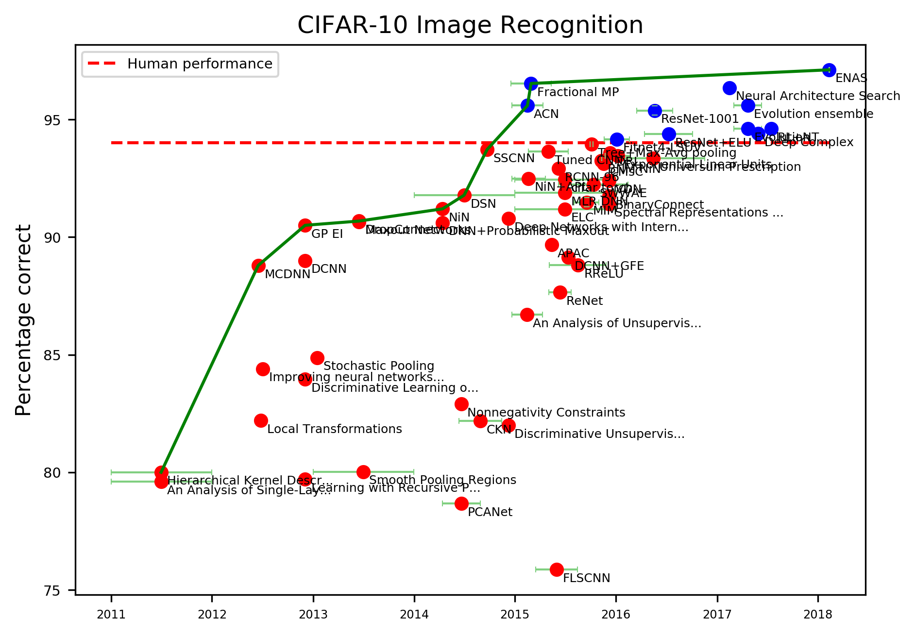

ML Starts to Achieve Superhuman Performance
At least in some domains

Slide 11
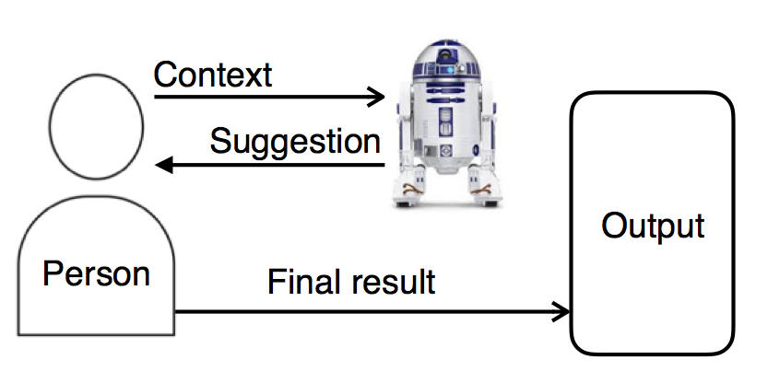
Machine-in-the-Loop Decision Making
Model how humans model AI (this lecture)
Fairness / Ethical considerations
Transparency / Interpretation
Trust / Reliance
…

Slide 12
What Can AI Do => What Should AI do
https://medium.com/@ChenhaoTan/human-centered-machine-learning-a-machine-in-the-loop-approach-ed024db34fe7

Slide 13
What Can AI Do => What Should AI do
https://medium.com/@ChenhaoTan/human-centered-machine-learning-a-machine-in-the-loop-approach-ed024db34fe7

Slide 14
Human-Centered Machine Learning
From Human-in-the-Loop to Machine-in-the-Loop
https://medium.com/@ChenhaoTan/human-centered-machine-learning-a-machine-in-the-loop-approach-ed024db34fe7

Slide 15
Human-Centered Machine Learning
From Human-in-the-Loop to Machine-in-the-Loop
Human-in-the-loop
Modeling human behavior in computation
Design AI/ML that account for human behavior
Machine-in-the-loop
Model how humans model AI (this lecture)
Design AI/ML that account for humans’ mental models (next lecture)
https://medium.com/@ChenhaoTan/human-centered-machine-learning-a-machine-in-the-loop-approach-ed024db34fe7

